Slide 1
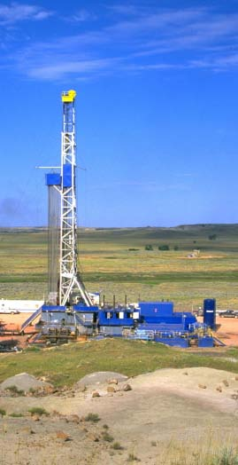
BLM Montana and Dakotas
Emission Inventories, Resource Management Plans (RMPs)
and
Environmental Impact Statements (EISs)
April 16, 2013
Susan Bassett
Air Resource Specialist
BLM Montana/Dakotas State Office

Slide 2
Welcome
Thank you for attending!
Provide context for this emission inventory effort
Goal: To achieve better air quality analysis with your participation

Slide 3
Reasons for Regional Emission Inventories
Support Photochemical Grid Modeling (PGM) for multiple RMPs and Associated EISs
Reduce costs for operators
Speed approval time for oil and gas projects
Provide high-quality data for other air resource studies

Slide 4
BLM Planning Efforts in MT/DAKs
Ongoing RMPs/EISs
Billings/Pompeys Pillar
Miles City Field Office
HiLine District
South Dakota Field Office
Future RMP/EIS Revisions
Lewistown Field Office
North Dakota Field Office
RMP/EIS | FR Notice of Availability
MCFO | 3/8/2013
HiLine | 3/22/2013
BiFO | 4/5/2013
SDFO | TBD

Slide 5
Montana/Dakotas Field Offices

Slide 6
PGM Modeling Domain

Slide 7
Air Quality Oil and Gas MOU
Signed June 23, 2011
Participants
US Environmental Protection Agency (EPA)
US Fish and Wildlife Service (USFWS)
National Park Service (NPS)
US Forest Service (USFS)
BLM specifically requests comments of Air Resource Management Plans (ARMPs) in RMP/EIS appendices

Slide 8
PGM Benefits
One model addresses:
Criteria pollutants
Air Quality Related Values (AQRVs) including visibility, deposition, lake acidification
Model “selected” alternatives for many field offices
Under Air Quality Oil and Gas MOU
Can “tier to” this PGM analysis rather than conduct new PGM analysis

Slide 9
Improve Emission Accuracy
“Conservative” emissions are the default unless adequate data is gathered to reflect actual operations
Equipment types
Basin-specific practices
Basin-specific emission controls
Compliance with new/recent regulations
We need your help
Now is the time to participate

Slide 10
Thank You!
Please contact me if you have questions.
Susan Bassett Air Resource Specialist BLM Montana/Dakotas State Office 406-896-5029 sbassett@blm.gov

